Slide 1
Parameter Estimation using MLE
Jayaraj P B
1

Slide 2
Parameter Estimation
It refers to the process of determining the values of the parameters of a model that best fit the given training data.
There are various techniques for parameter estimation, the choice of method depends on factors such as the complexity of the model, the amount of available data, and computational considerations (eg. MLE)
It's common to split the dataset into training and testing sets, and sometimes a validation set, to evaluate how well the model generalizes to new, unseen data.
Parameter estimation is a crucial step in the machine learning workflow as it directly influences the predictive performance of the model.

Slide 3
Population, Sample and Probability density function
For example, given a sample of observation (X) from a domain (x1, x2, x3, …, xn), where each observation is drawn independently from the domain with the same probability distribution (so-called independent and identically distributed, i.i.d., or close to it).
The problem is made more challenging as sample (X) drawn from the population is small and has noise, meaning that any evaluation of an estimated probability density function and its parameters will have some error.

Slide 4
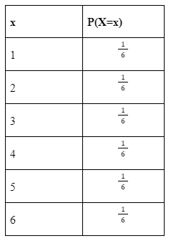
A random variable is a set of all possible values of a random experiment. For ex.- Consider rolling a fair six-sided die. The random variable X can represent the outcome of the roll, ranging from 1 to 6, i.e. X={1,2,3,4,5,6}
A probability distribution is a list of all possible outcome of a random variable along with their corresponding probability values.

Slide 5
Population:
In statistics, the population comprises all observations (data points) about the subject under study.
An example of a population is studying the voters in an election. In the 2019 Lok Sabha elections, nearly 900 million voters were eligible to vote in 543 constituencies.

Slide 6
Sample:
In statistics, a sample is a subset of the population. It is a small portion of the total observed population.
An example of a sample is analyzing the first-time voters for an opinion poll.

Slide 7
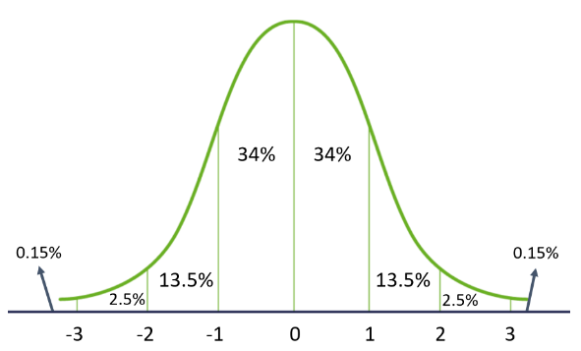
Properties of Gaussian Distribution:
-The mean, median, and mode are the same
-It has a symmetrical bell shape

Slide 8
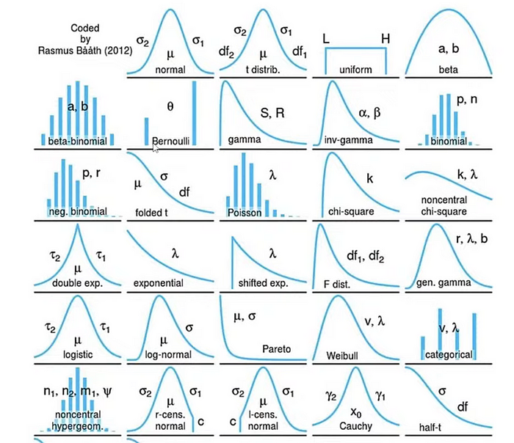

Slide 9
Gaussian distribution
In statistics and probability, Gaussian (normal) distribution is a popular continuous probability distribution for any random variable.
It is characterized by 2 parameters (mean μ and standard deviation σ).
Many natural phenomena follow a normal distribution, such as the heights of people and IQ scores.

Slide 10
Since the data that we have is mostly randomly generated, we often don’t know the true values of the parameters characterizing our distribution.
An estimator is like a function of your data that gives you approximate values of the parameters that you’re interested in.
This is because we only use a small subset of observations to derive the outcome.
This problem is referred to as Probability Density Estimation as we use only a random sample of observations to find the general density of the whole sample space.

Slide 11
MLE
The fundamental idea behind MLE is to find the values of the parameters that maximize the likelihood of the observed data, assuming that the data are generated by the specified distribution.
Naturally, the first thing would be to identify the distribution from which we have obtained our data.
Next, we need to use our data to find the parameters of our distribution.
A parameter is a numerical characteristic of a distribution. Normal distributions, as we know, have mean (µ) & variance (σ²) as parameters

Slide 12
Maximum Likelihood (ML) Estimation
ML estimation tries to find the estimate of the parameter θ by maximizing the likelihood function.
Assume we have i.i.d random samples x₁,x₂, . . .,xₙ that follow a distribution f(x₁,x₂, . . .,xₙ;θ), which depends on the unknown parameter θ.
The goal is to estimate this unknown quantity such that it maximizes the probability of observing this random sample.

Slide 13

Following is how to formulate this problem using the maximum likelihood:
Construct the likelihood function
L(x|θ) = f(x₁,x₂, . . .,xₙ;θ)
2. Use the property of i.i.d random samples to break the joint PDF to the product of n marginal PDF.
3. Take a logarithm (usually a natural log) to change the product to summation. This does not change the optimal estimator since the logarithm is a monotonic function.

Slide 14

4. Differentiate the log-likelihood function with respect to θ and set it to zero.
5. The estimator will only be a function of observed data.
The goal of MLE is to find the values of the model parameters (θ) that maximize the log-likelihood function.

Slide 15
Maximum Likelihood estimation (MLE)
MLE is a probabilistic approach that aims to maximize the likelihood of the observed data given the model parameters.
In the context of regression, it involves finding the parameter values that maximize the likelihood function.
How can the Mean Squared Error (MSE) loss function in linear regression be derived from the concept of Maximum Likelihood estimation (MLE)? We are investigating it now

Slide 16
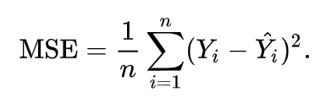
Mean Squared Error (MSE)
MSE, a popular metric in regression models, quantifies the average of the squared differences between the predicted and actual values.
While MSE primarily concerns machine learning, MLE is a powerful concept in statistics.
In essence, MLE aims to find the model parameters that maximize the likelihood of the observed data.

Slide 17
Connection between MLE & MSE
When we dig deeper into these concepts, the connection between MSE and MLE unfolds.
This connection comes to light when we assume that the model’s errors are normally distributed – a common assumption in many statistical models.
Imagine you’ve observed some data and want to model it with a particular distribution, say normal
However, the parameters of this distribution – mean and standard deviation – are unknown.
MLE helps find these parameters such that the probability of observing the given data is maximized.

Slide 18
MLE & MSE
When we model errors with a normal distribution, the process of MLE, which maximizes the likelihood of the observed data, turns equivalent to minimizing the MSE.
Let’s take the log-likelihood for normally distributed errors.
Maximizing the log-likelihood equates to minimizing the MSE.
Hence, under normally distributed errors, MSE and MLE become different sides of the same coin.

Slide 19
MLE & MSE
The understanding of MSE as a MLE tool unveils a new perspective on machine learning metrics. It’s not just a measure of prediction error but a sophisticated statistical estimator.
Knowing this connection improves the model optimization process, potentially leading to more accurate predictions
Understanding that MSE minimization is equivalent to maximum likelihood estimation solidifies the statistical underpinning of the machine learning work.
The potential of MSE extends beyond being a mere performance metric. When viewed through the lens of MLE, it transforms into a statistical tool for parameter estimation.

Slide 20
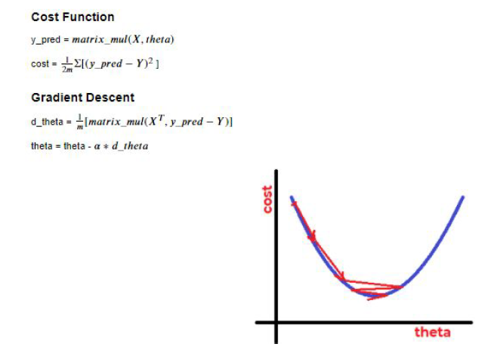

Slide 21
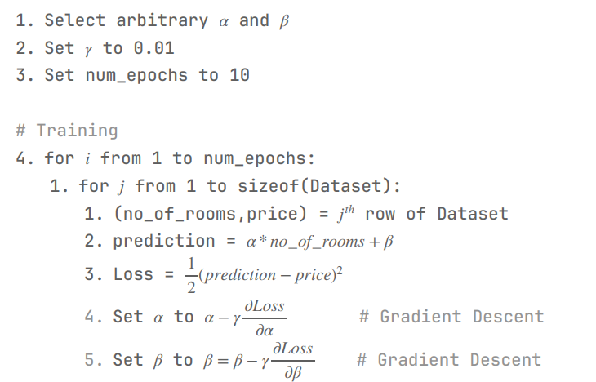
MLE for optimizing GD in Linear Regression solver

Slide 22
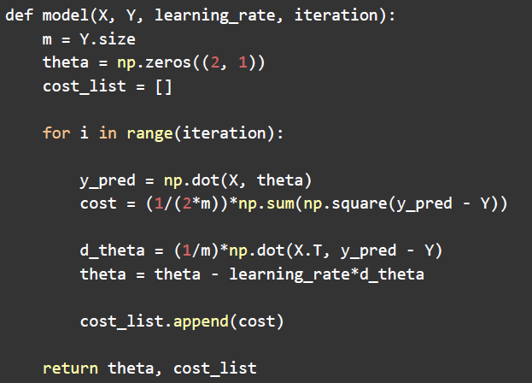
Python Code for Linear Regression implementation

